Slide 1

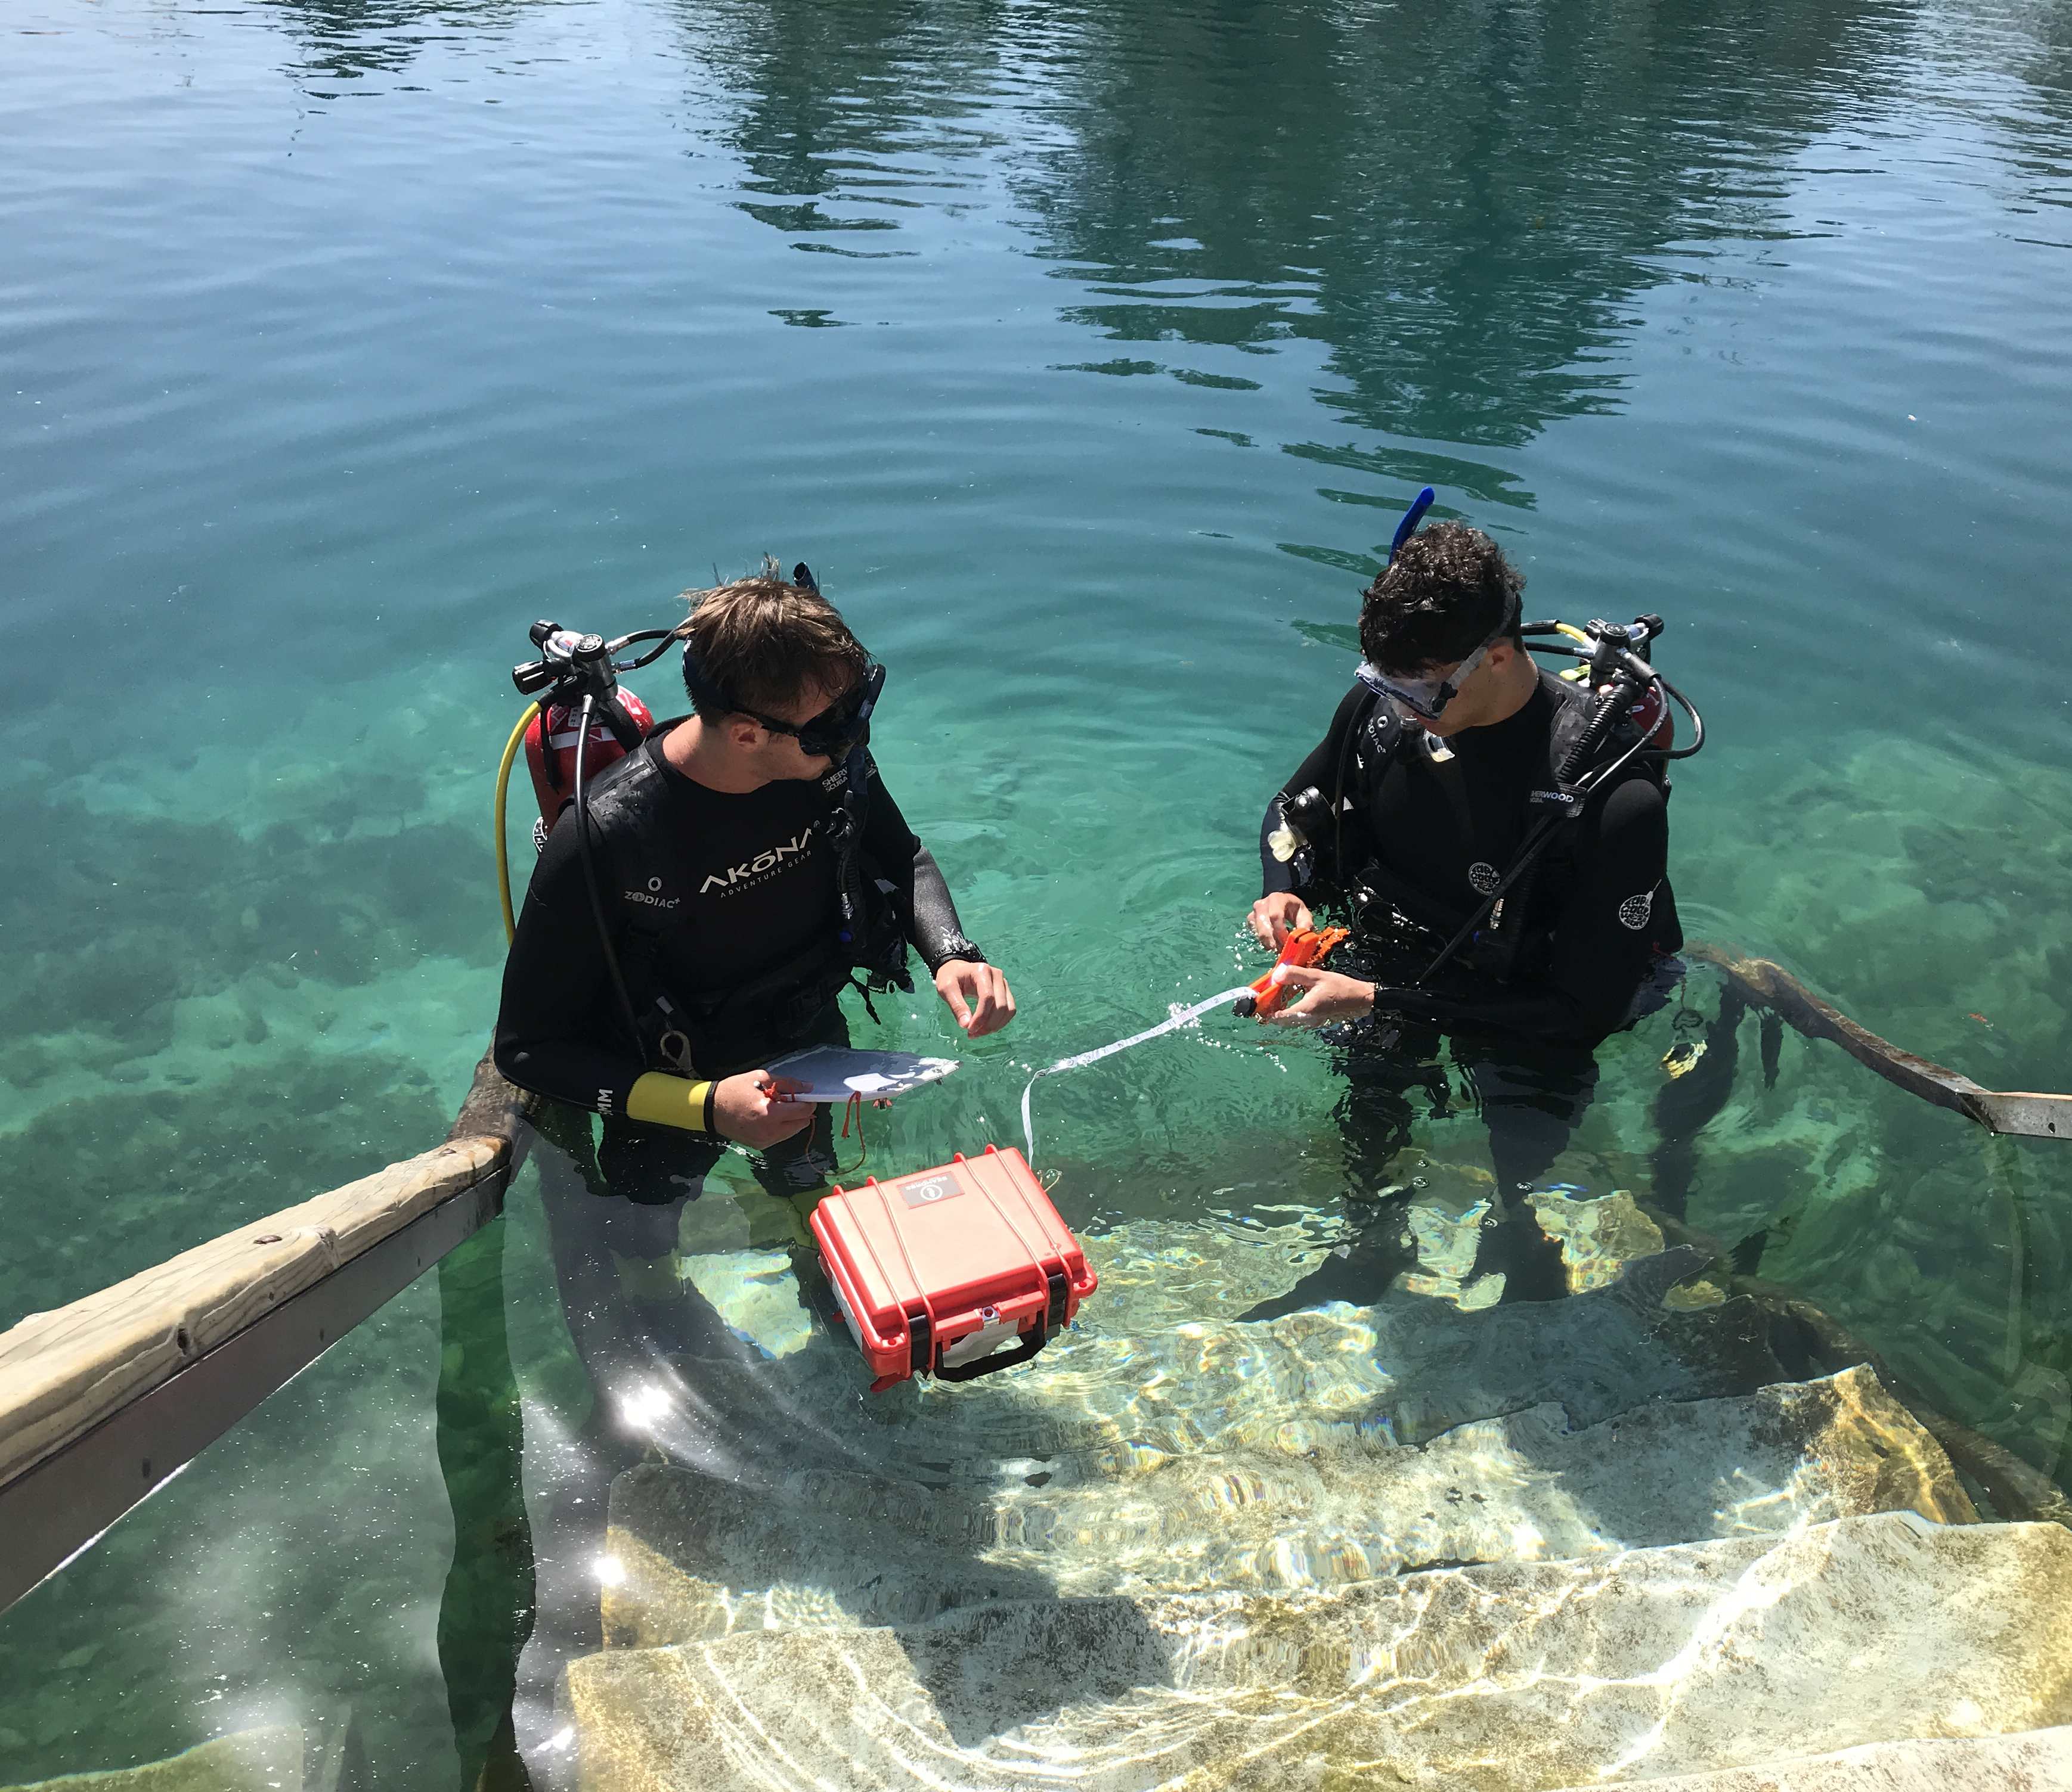
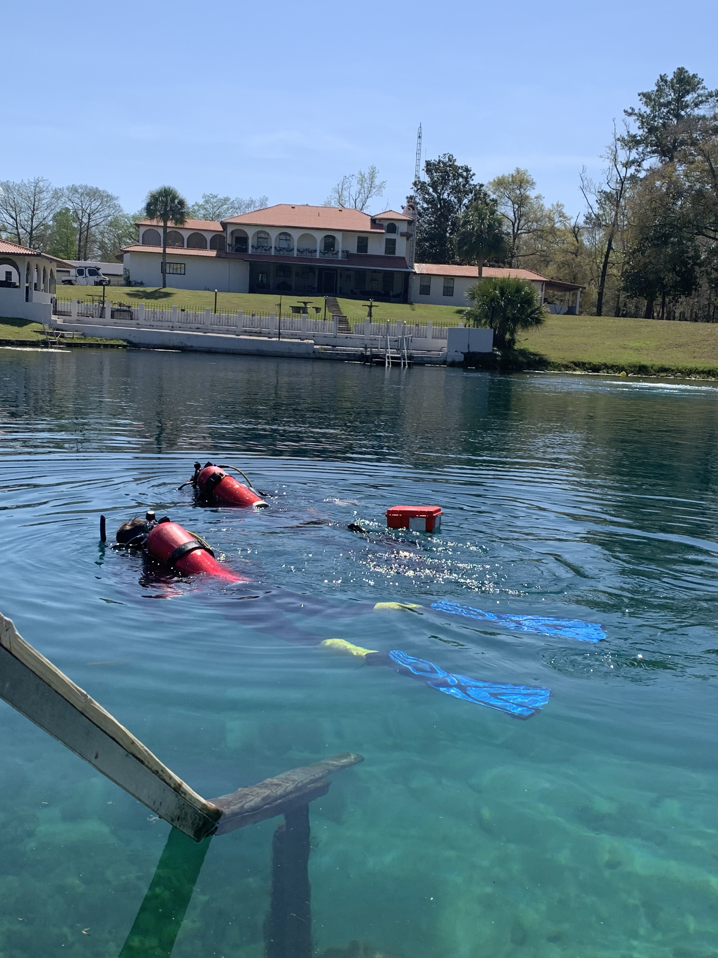
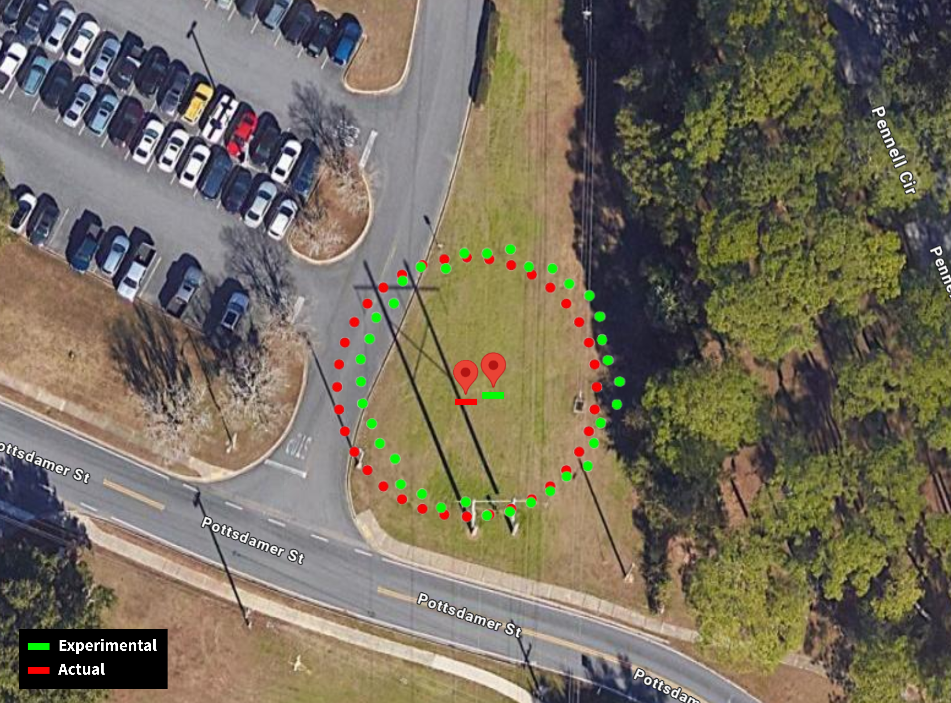
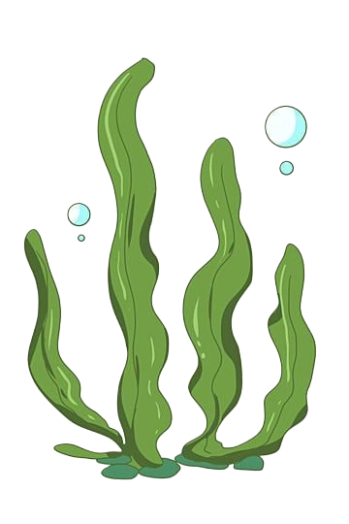
Team 520: Underwater Diver GPS Correction
Team: J. Baumann, N. Boggess, C. Carlson, M. Jadush, M. Jean-Baptiste, A. Snell
Sponsor: Andrew Rassweiler, Ph.D Manager: Shayne McConomy, Ph.D Advisor: Jonathan Clark, Ph.D
The objective of this project is to create a system capable of determining and recording a diver’s position while submerged.
Background
Procedure
GPS is incapable of penetrating through water. It relies on radio waves which decay rapidly in liquid.
The purpose is to pinpoint the location of sick coral reefs in Bonaire.
Originally, a GPS in a Pelican case was attached to the diver with a dive line.
The previous system has an error of 10+ m.
Before Dive:
Charge GPS
Clip mounts to bottom of waterproof box
Attach end of measuring line to mount
Attach reel, compass, and waterproof writing pad to diver
Once ready to start dive, start GPS track
During Dive:
At each point of interest record
  Time
  Depth
  Compass heading
  Measuring line length
Once dive is complete, stop GPS track
After Dive:
Import GPS data into the app as a .xslx or .gpx file
Input values taken from dive to get diver's underwater coordinates outputted
Results
Key Goals
The system will be able to reliably work at a depth underwater up to 10 m.
It will pinpoint the diver's position within a 3 m radius.
The system will be portable, capable of launching from the shore, and require minimal setup.

